Slide 1
Welcome
Crosswind Commons
Annual Meeting 2026
Agenda
Board Introduction
Covenant Reminders
Common Space-Butterfly Garden
New Website
Financial Review
Around our Neighborhood
  Duke Substation
Volunteers
Questions
Meeting Conclusion

Slide 2
Introductions
President
  Laura Getch
Vice President
  Aimee Rawlings
Treasurer
  Kelly Honn
Secretary
  Ginger Hodge
Architectural Committee
  Brad Force
  Jon Getch
Member
  Catherine VanDyke

Slide 3
Covenant Reminders
  Speeding
  Garage Lights
  Trash Bins
  Maintaining Homes
  Homeowners must submit a request before performing any changes or additions to the outside of the home (including decks, porches, siding, etc)
    Architectural request forms can be found on the website or can be emailed

Slide 4
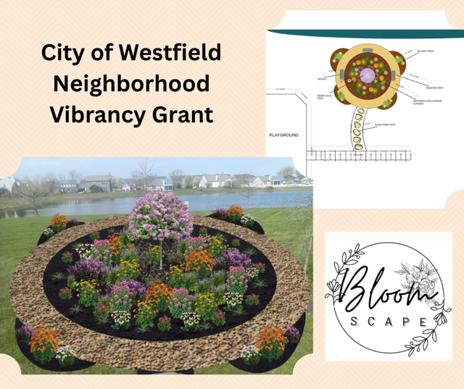
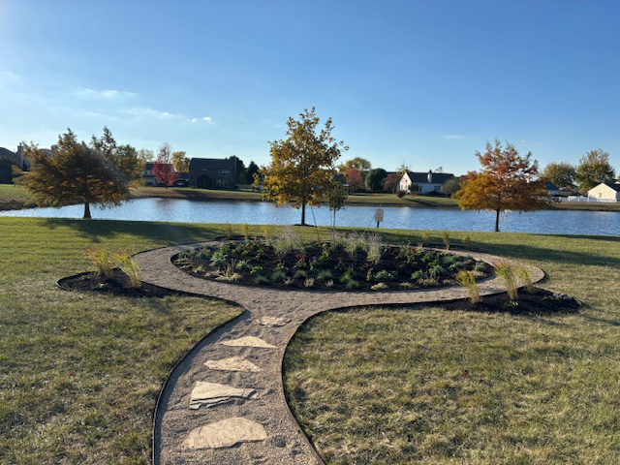
Butterfly Garden

Slide 5
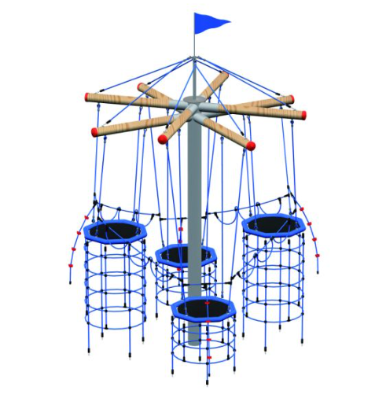
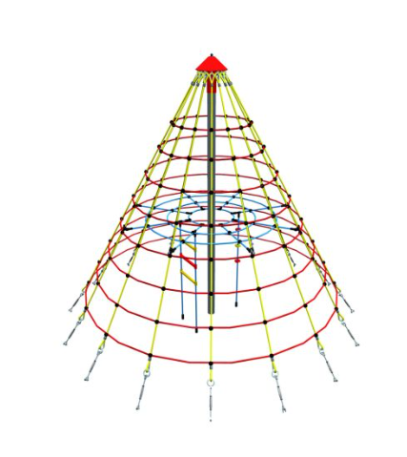
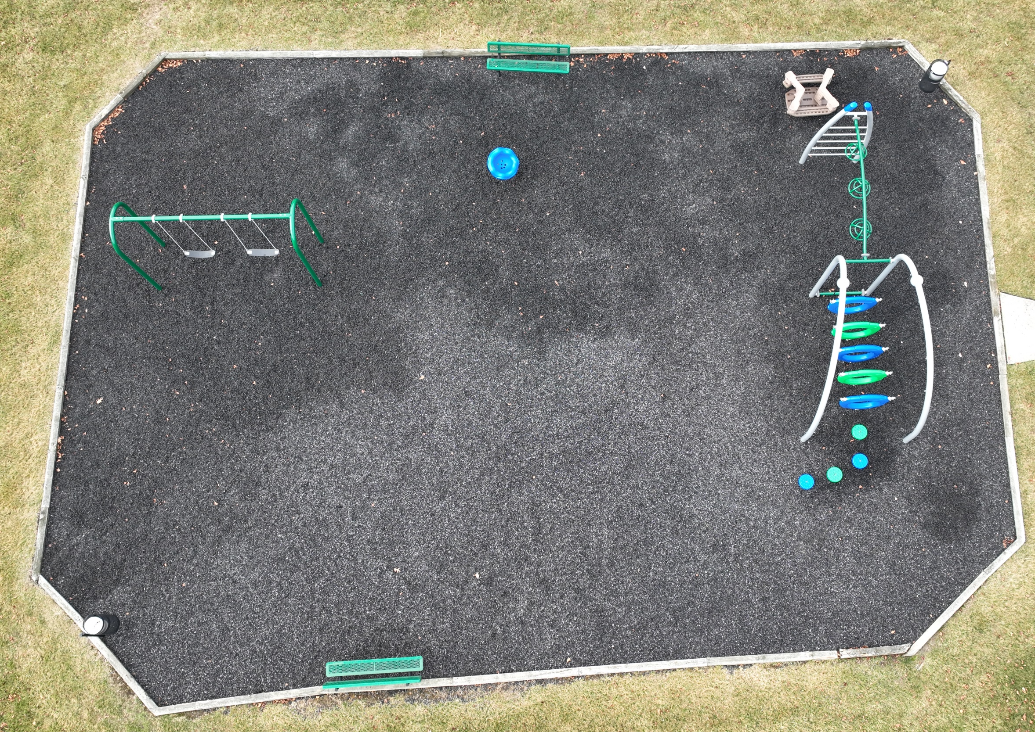
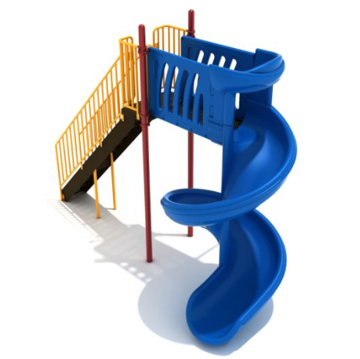
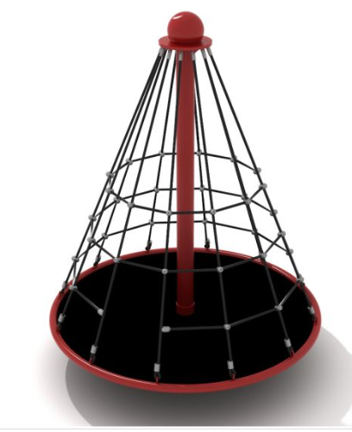
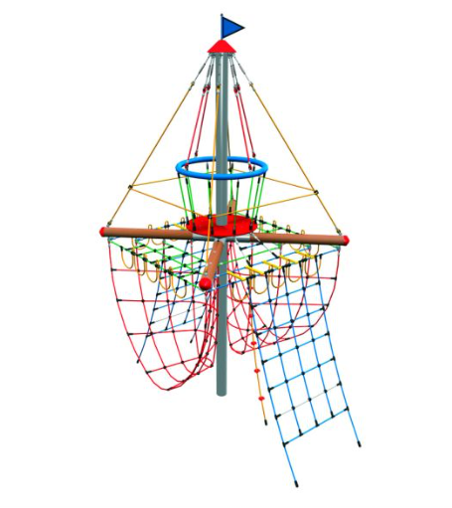
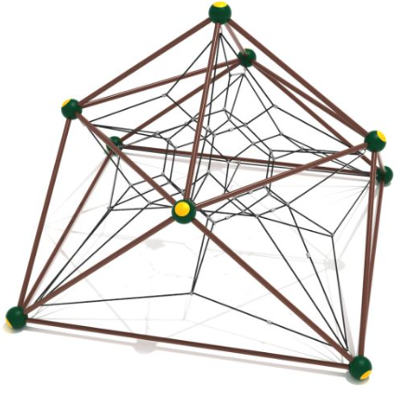
Playground
Future Piece of Equipment Placement

Slide 6
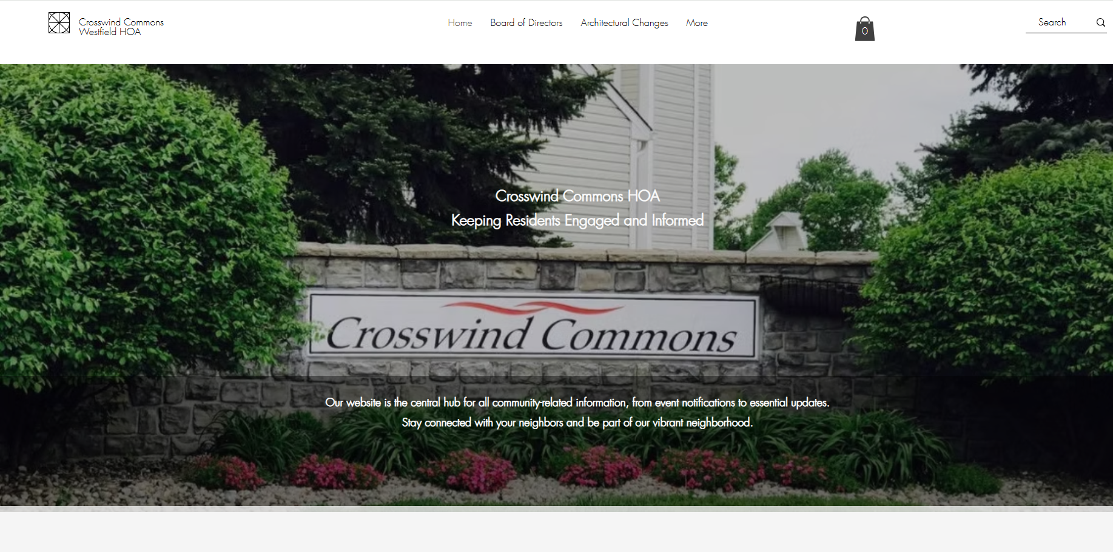
New Website - www.crosswindcommonswestfield.com

Slide 7

 | 2021 Actuals | 2022 Actuals | 2023 Actual | 2024 Actuals | 2025 Actuals | 2026 Proposed
ADMINISTRATION | $232.02 | $696.19 | $281.46 | $297.97 | $514.97 | $500.00
BEAUTIFICATION | $211.86 | $790.80 | $2,314.22 | $312.10 | $457.36 | $8,000.00
INSURANCE | $1,361.00 | $1,459.00 | $1,497.00 | $1,552.00 | $1,539.00 | $1,700.00
LEGAL | $2,003.32 | $915.00 | $1,138.59 | $154.43 | $0.00 | $1,000.00
MOWING | $4,937.77 | $4,917.77 | $4,911.71 | $5,544.63 | $4,983.84 | $5,000.00
POND MAINTENANCE | $2,800.00 | $3,620.00 | $3,900.00 | $4,020.00 | $3,540.00 | $4,270.00
POND UPKEEP | $3,925.00 | $1,947.00 | $0.00 | $0.00 | $0.00 | $1,500.00
PROPERTY TAXES | $73.28 | $111.78 | $43.30 | $73.28 | $112.00 | $100.00
UTILITIES | $462.20 | $314.20 | $421.78 | $402.48 | $373.82 | $500.00
WEBSITE | $199.00 | $199.00 | $199.00 | $199.00 | $378.00 | $0.00
BUTTERFLY GARDEN |  |  |  |  | $5,000.00
 | $16,205.45 | $14,970.74 | $14,707.06 | $12,555.89 | $16,898.99 | $22,570.00
Grant Money Received $10,000
2026 DUES $350.00 Due April 15th, 2026

Slide 8
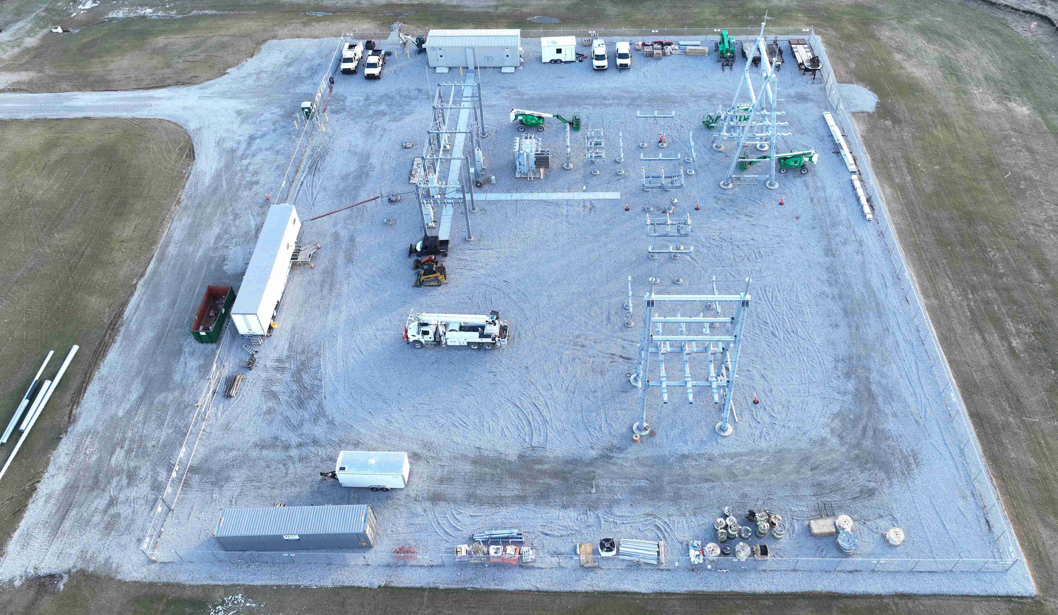
Duke Substation 156th/Springmill
Current View

Slide 9

We’re looking for volunteers to help with projects as they come up.
Want to be part of the action?
Sign up before you leave and stay in the loop!

